Slide 1

Packing for JET!

Slide 2
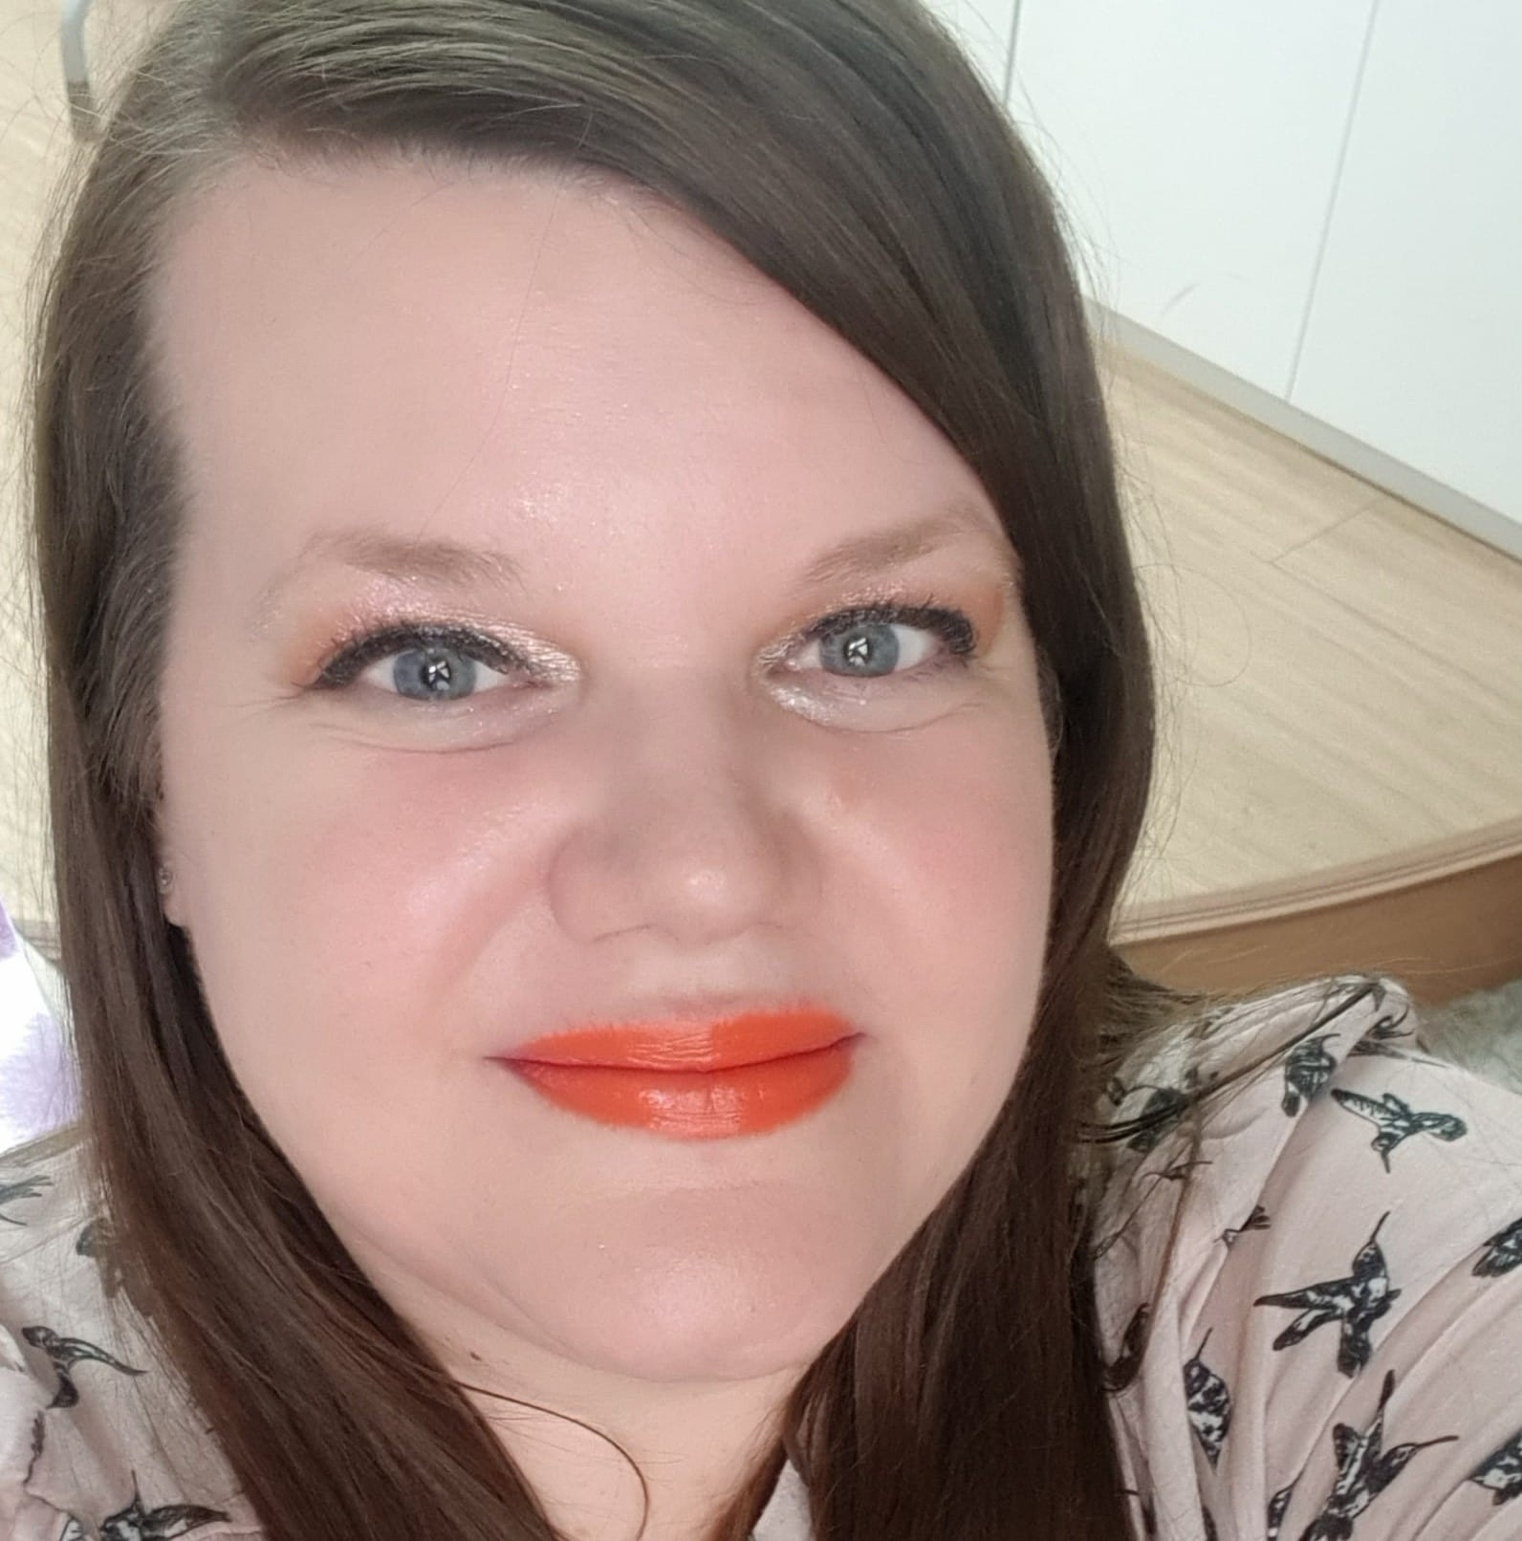
About Me …
I am from South Dakota.
I was a JET ALT in Ibaraki- ken from 2008 to 2011.
After JET, I taught in private schools (not eikaiwa) in Japan for three years.
I taught in the EPIK Program in Korea, which is like JET, from 2014 to 2023.
I went to Japan A LOT after I moved to Korea, and I love shopping in Japan!

Slide 3
Table of Contents
01
02
03
04
05
06
Money
Baggage
Shopping
When and Where to Get ¥!
Baggage Allowance For Your Flight!
Local and Western Options in Japan!
Electronics
Omiyage
Miscellaneous
What to Bring, What to Buy There!
What to Bring, When To Give It …
Final Thoughts!

Slide 4
01
Money
When and Where to Get ¥!

Slide 5
Where To Get ¥
Wells Fargo
Tokyo
There are many options! Ask the Keio Plaza Hotel.
In the Wells Fargo Center downtown Portland.The rate won’t be good.
PDX
Narita
You probably won’t have time unless you go early …
You probably won’t have time …
SEATAC
You will have a time because you have a long layover!

Slide 6
Money Continued …
Bringing USD to Japan
Traveling with JPY
$
¥
The USD is strong against the JPY. If you have $ to bring into Japan, it will go far!
If you are paying debts in the U.S., such as student loans or credit cards, it is better to keep your $ in the U.S.
JPY is the 3rd most traded currency in the world. It is good to travel with, especially in Asia!

Slide 7
Credit Cards in Japan
Are less accepted in rural areas and small businesses. Always carry ¥
Look into getting a Japanese cc, though they can be hard to get.
Are widely accepted in large cities and big “chain” businesses.
There are remittance fees for sending money to the U.S. Keep that in mind if you use your U.S. card in Japan.

Slide 8

ATMs in Japan
Post Office
Kobini’s
Banks
Japan Post has locations throughout Japan
7-11, Family Mart, Lawson, etc.
Some Japanese banks offer international ATMs

Slide 9
02
Baggage
Baggage Allowance For Your Flight!

Slide 10
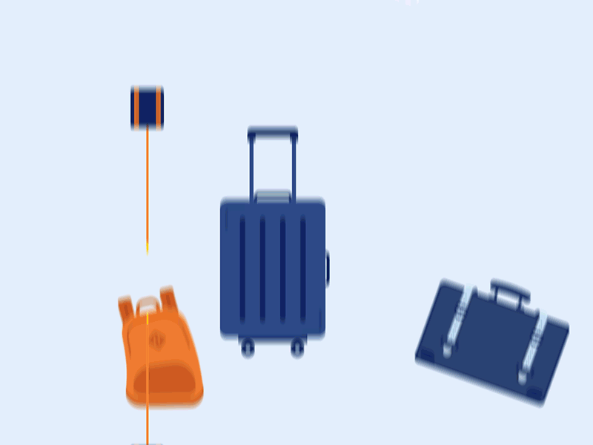

Baggage Allowance Options …
Ask Matt!
Option #1
Option #2
1 check-in at 50 pounds
1 carry-on
1 personal item
2 check-in at 50 pounds each
No carry-on
1 personal item
That’s All!

Slide 11
Suitcases:
The weight limits are 50 pounds or about 23 kilograms for check-in.
Be careful about using the vacuum pack bags to pack, as it can make your suitcase go overweight really quickly.
If your suitcase is overweight, you will have to pay the difference.
Keep in Mind…
The allowance of what the airline allows you check-in and carry-on is based on the ticket type, regardless of your status with the airline.
Finally …

Slide 12
Also…
Surface shipping doesn’t to Japan doesn’t exist!
You can pay to check-in an additional bag, but …
  The airline might reject it due to load weight on the aircraft.
  You would have to pay to send it from Tokyo to your placement.

Slide 13

In Japan…
You will need business attire at orientation, and your school will likely have a business or business casual dress code
Japan’s climate varies, but most areas have four distinct seasons
It will be quite hot and humid for the first two months; winter will be quite cold depending on where you are located

Slide 14
Throughout This Presentation …
Watch the presentation, see what is available in Japan, think about what might be better to get in Japan and what might better to bring from the U.S.

Slide 15
03
Shopping!
Local and Western Options in Japan!

Slide 16
Even if you are considered “straight size” in the U.S., you might be considered plus size in Japan.
I am very comfortable using terms such as “plus size” or “big size’ and I will use them in this presentation.

Slide 17
15 % to 20%
I estimate that
Of my current wardrobe comes from Japan.
Not to mention other products, such as skincare and make-up.
I love shopping in Japan!

Slide 18
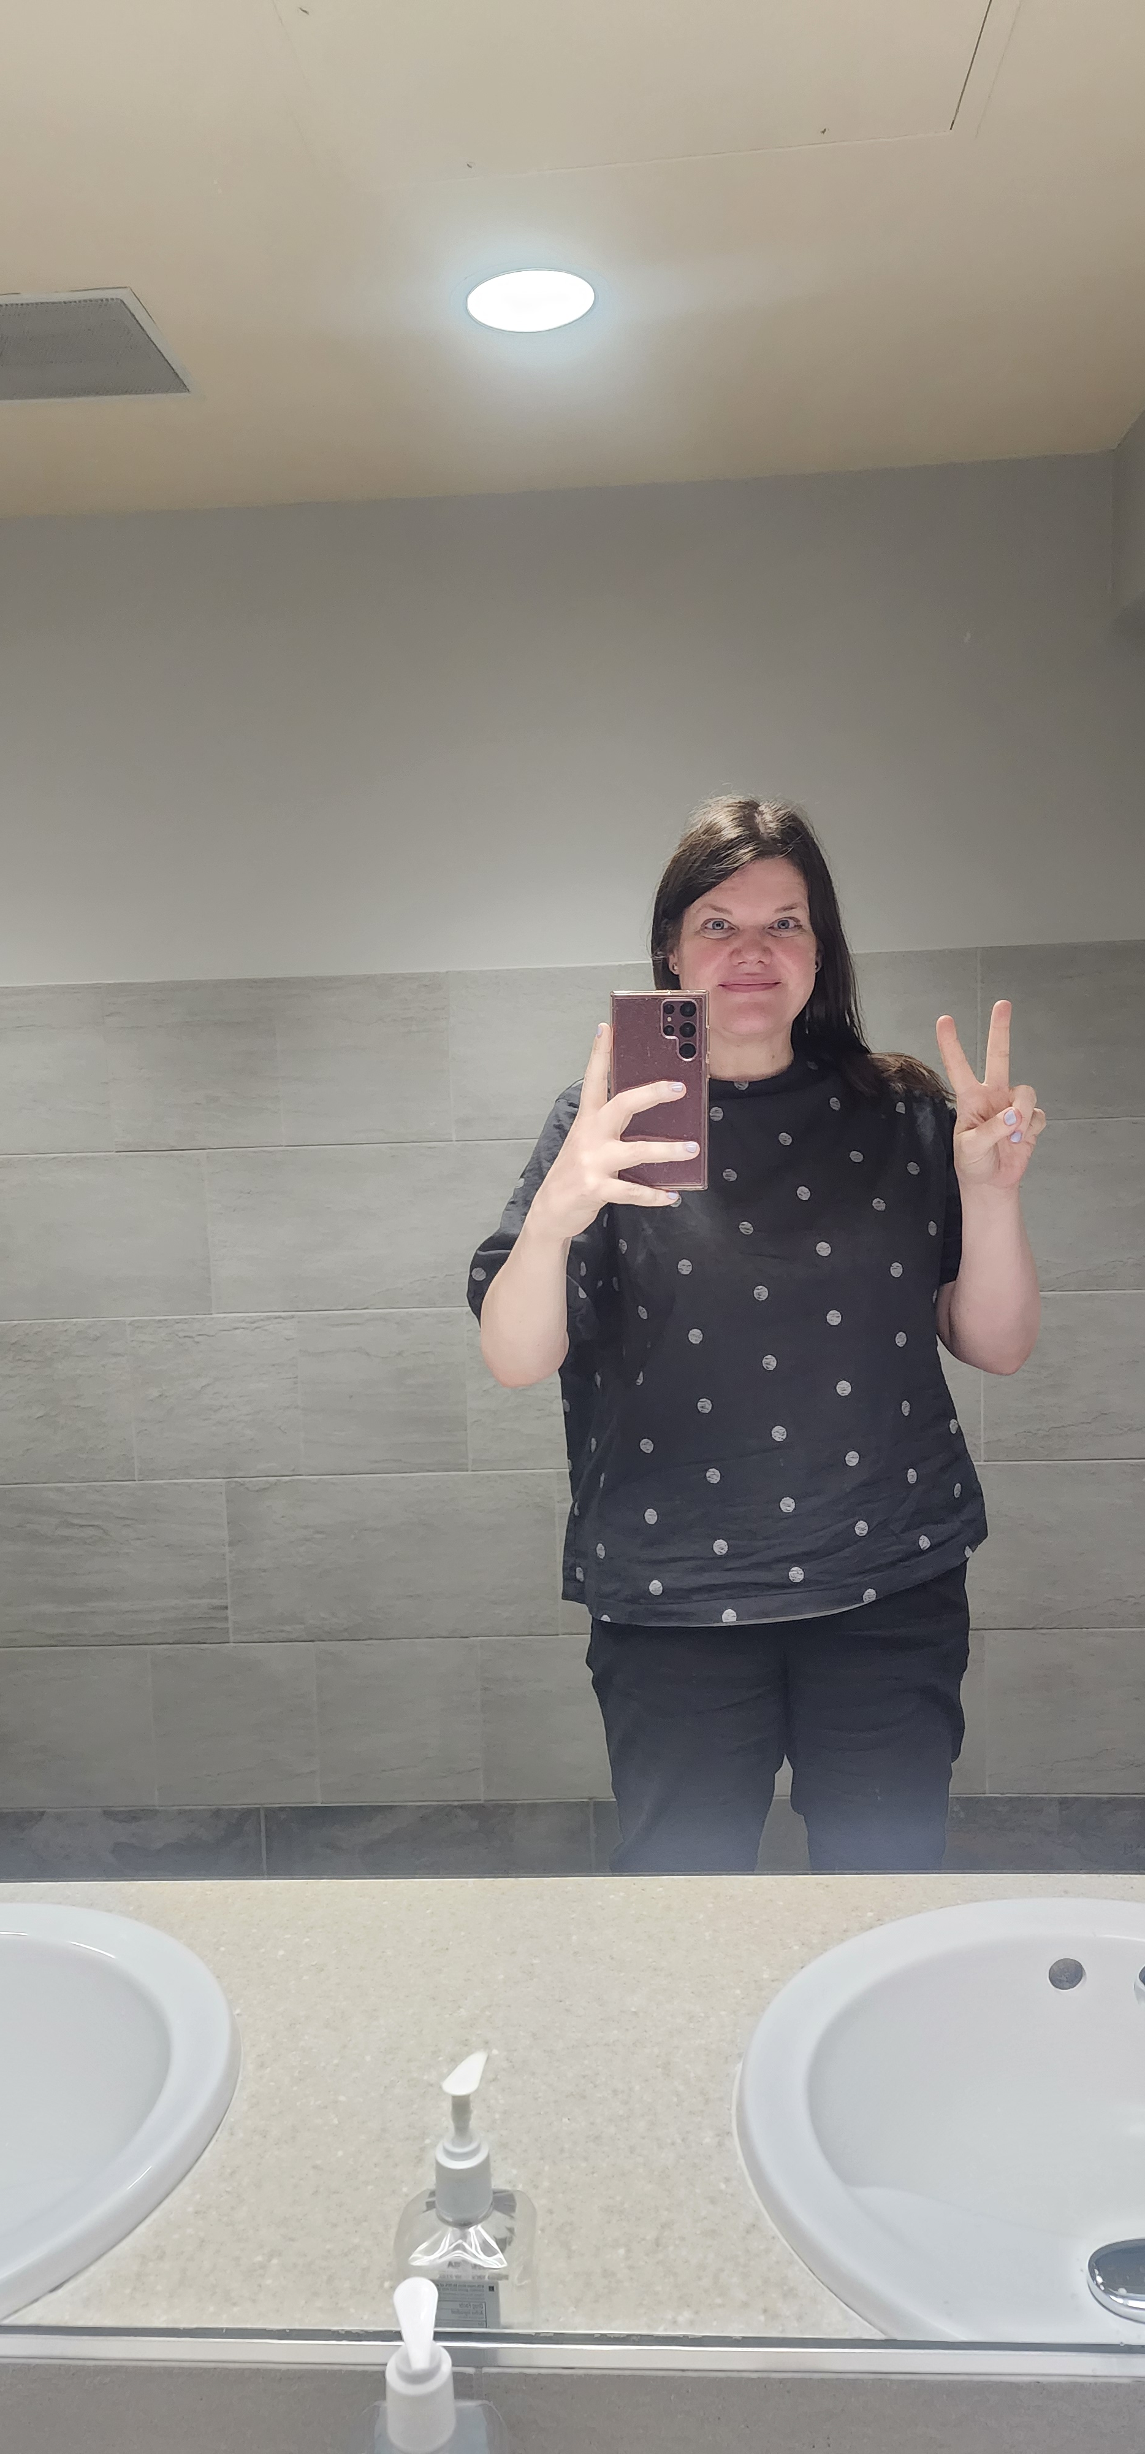
Anna’s stats …
I am considered plus size in the U.S.
I wear a U.S. L/XL shirt size, and I can wear a 3L or 4L shirt size in Japan
I am a U.S women’s shoe size 9.5 or 10 and have slightly wide feet. I wear a 25.5 or 26 in Japan, or 4L depending on the brand
Pants are a little more challenging, I am a women’s U.S. size 14/16, which is 4L in Japan.
  I tend to look for pants with 100 cm waist
  Length can be an issue, as I am 5’9” or 176cm
I have bought socks in Japan, mostly men’s sizes; I have never bought undergarments in Japan

Slide 19
Clothing…
Work:
Don’t wear black ties (funerals)
No logos, cleavage, short skirts, shorts, jeans, sleeveless shirts at work. Dress smart!
Bring indoor shoes for work
  Many alumni said Crocs are common indoor shoes
Shoes:
Women’s go up to about 8.5 or 9 (Japan size 25)
Men’s go up to about 10.5 or 11 (Japan size 28)
  Many alumni recommend bringing shoes if you have a larger shoe size
Tip:
Learn your waist size in centimeters and it will help you find which size that you are in Japan!

Slide 20


Clothing Brands in Japan
Plus size men’s and women’s retailer, suits
Urban areas. Check online for locations
Kind of expensive
Famous Japanese casual wear designer and retailer
All over Japan.
Same parent company as Uniqlo
More affordable than Uniqlo
All over Japan
Plus size women’s retailer
All over Japan
Can be expensive
Retailer that sells international brands such as Fila and Hanes
Mostly in the Tokyo area.
Likely expensive
All over Japan, including rural areas
Carries big sizes
Affordable

Slide 21



Clothing Brands in Japan
Plus size retailer that sells local and international brands
All over Japan
Can be expensive, but has good sales
All over Japan, not in rural areas
Sizes might be limited compared to the U.S.
Relatively affordable
All over Japan, not in rural areas
Sizes might be limited compared to the U.S.
Kind of expensive
Check your area for plus size or big and tall shops!
Some supermarkes will have familiar products
Walmart used to own a large share in Seiyu
All over Japan in urban areas
Carries big sizes
Affordable
U.S. membership works in Japan!
Thrift store
All over Japan
Affordable
There are locations in Portand!

Slide 22
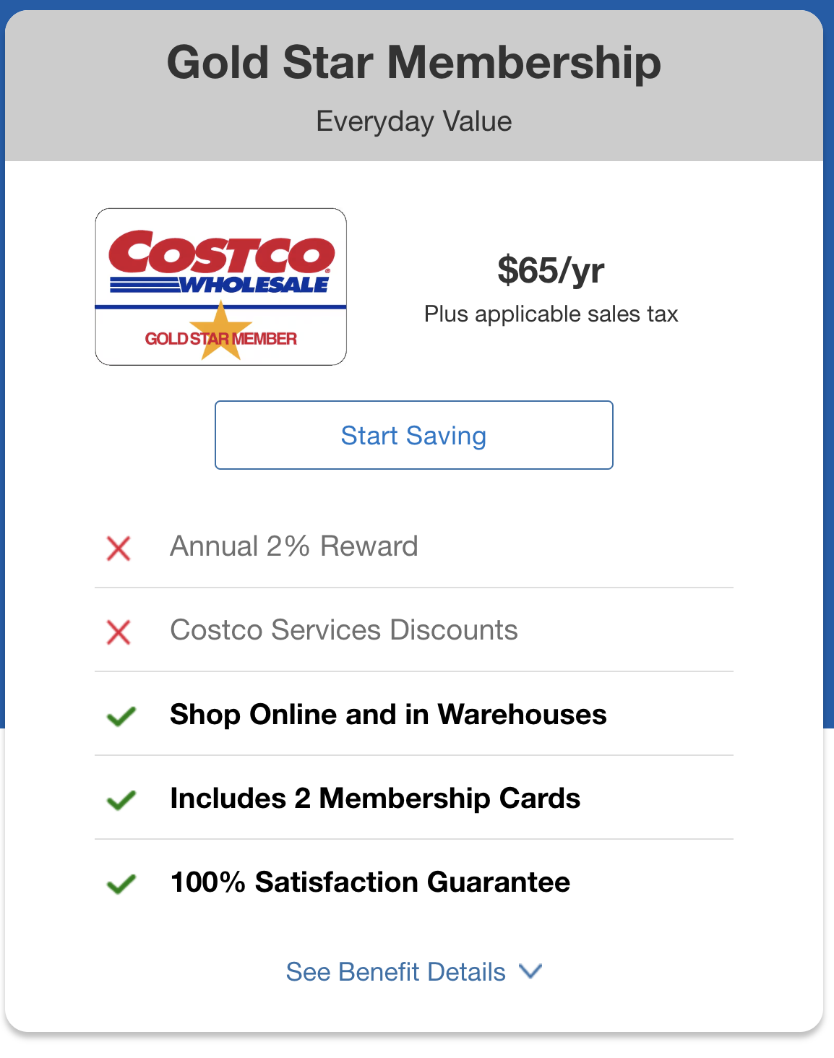
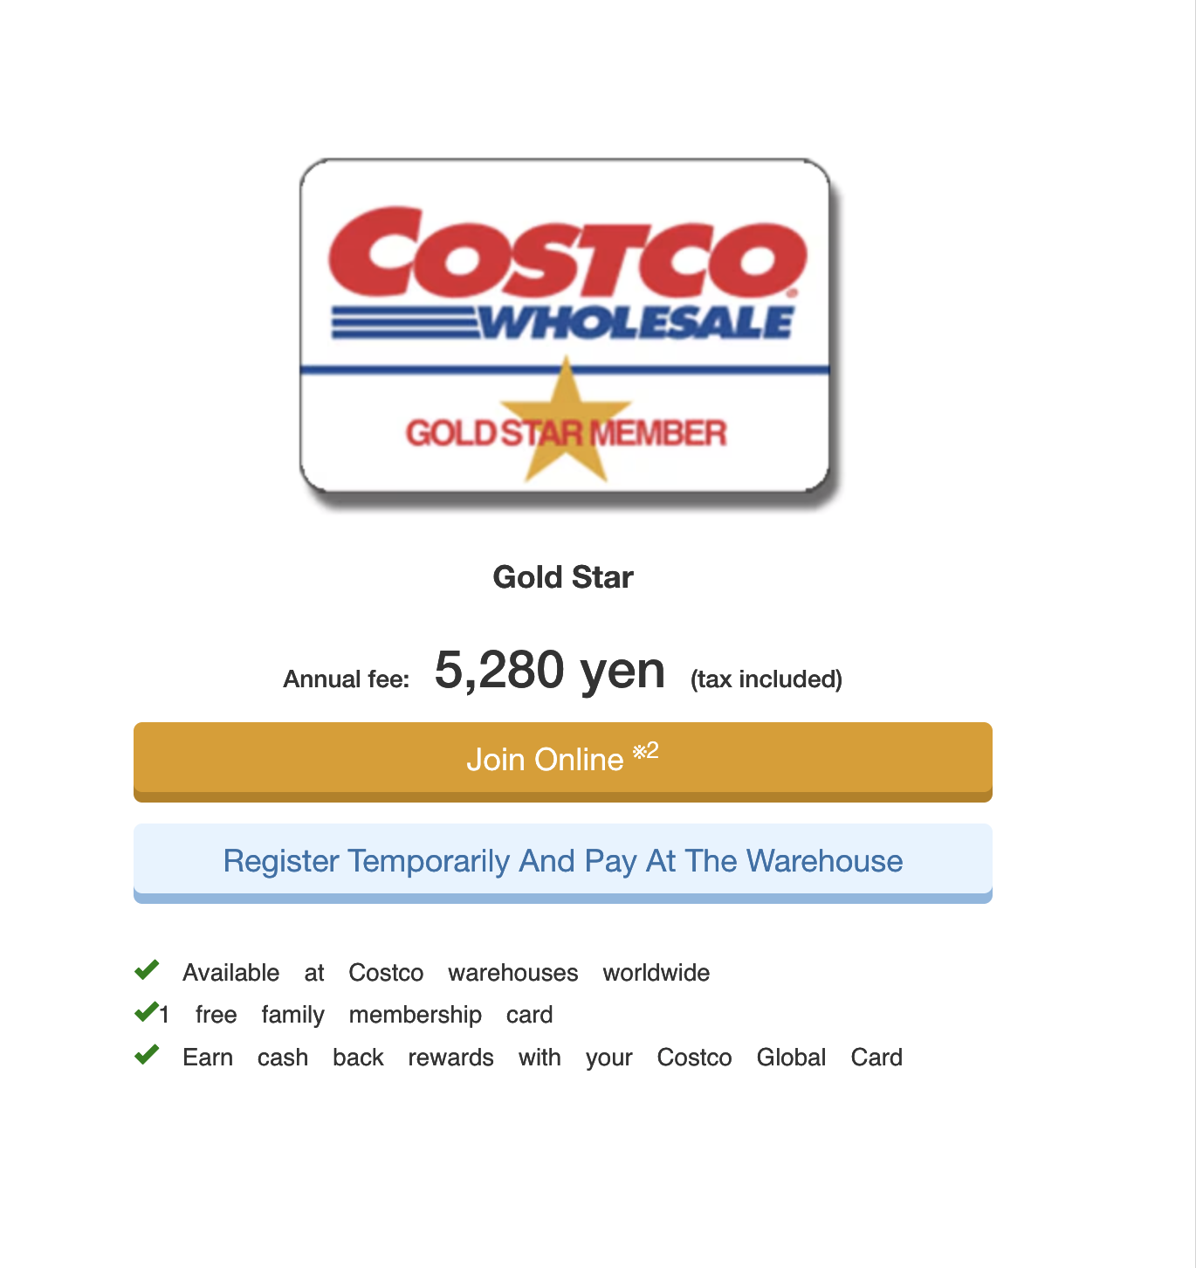
Keep in mind …
The membership benefits, such as online shopping, don’t transfer overseas.
Costco can’t access your account from overseas.
There are services that U.S. memberships offer that Japan memberships don’t offer, and vice versa.
If you get a membership in Japan, you will eventually have to get a U.S. membership when you move back.
about $33!

Slide 23


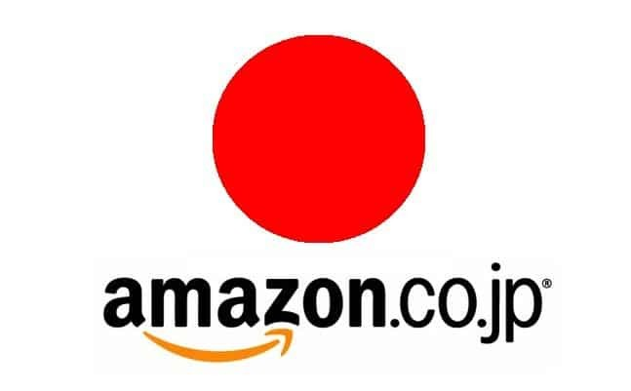



Western Products in Japan
A Japanese supermarket that sells international goods
All over Japan
Online shop from Costco Japan
Need to make a Japan Amazon account
Should deliver to all parts of Japan
Online retailer that has some international goods
Usually near Costcos in Japan, but there are more Costcos than Ikeas
All over Japan
Has grocery items from Sweden
U.S. based online retailer that sells wellness products and food
Ships to Japan
Watch out for shipping costs

Slide 24
04
Electronics
What to Bring, What to Buy There!

Slide 25

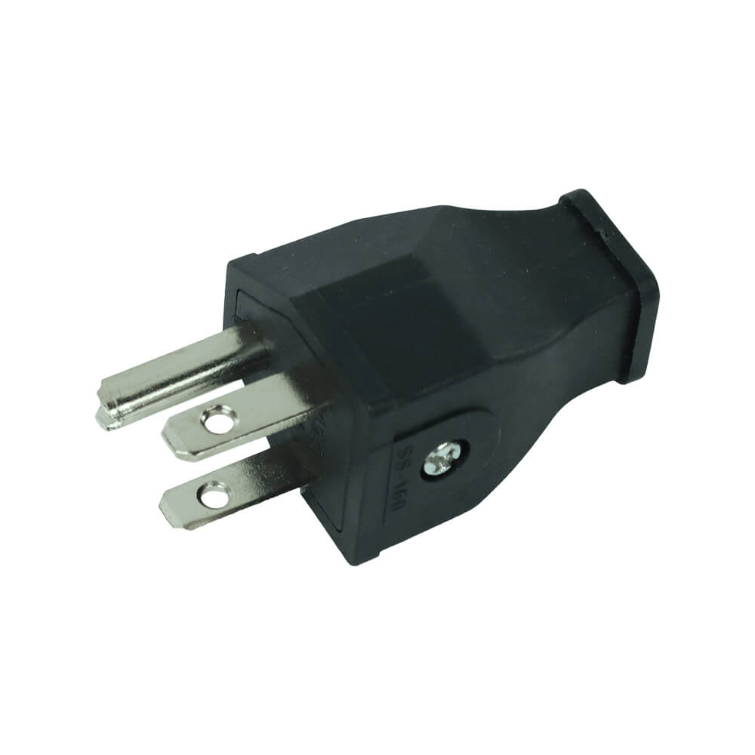
Electronics
Phones
Personal
Grooming Tools
Not Sure?
Most phones are unlocked
Check your carrier
Your laptop and other devices should work fine
Have a USB for work
An alumni recommends bringing a router
I brought a hair dryer from the U.S. it was fine
My friend brought a hair dryer from Japan and it was fine
Another friend brought a hair dryer from Japan and it burned!
My Japanese hair dryer works fine!
When it doubt buy in Japan!

Slide 26
05
Omiyage
What to Bring, When To Give It …

Slide 27
The Awkardness of Omiyage
Don’t Stress!
If you don’t know what to get, talk to your predecessor or other teachers
Remember…
You will come during summer vacation. You might not visit all of your schools right away. If you do, many staff will be on vacation
Waiting is Ok
It’s ok to wait to get and give omiyage at a later time
Some JETs have brough omiyage from Tokyo

Slide 28



Tips for Omiyage …
Individually wrapped items
Light weight
Made in Oregon store is a good option
A few alumni recommended Stash tea
I brought Smith Teamaker last year, only to discover they have a location in Shibuya and the tea is sold on Amazon Japan
Friends say that Trader Joe’s is a good option

Slide 29
06
Miscellaneous
Final Thoughts!

Slide 30
Services
Dressing for Work
Medication
Other Foreigners
Ask your predecessor what is available for doctors, dentists, salons, etc.
Look at what the other teachers wear for guidance
Japan has plenty of over the counter medication
Some alumi and friend in Japan recommend bring some anyway …
The closest foreigners to you may not be JETs. People from all over the world live in Japan. Find the nearest community

Slide 31
What to pack…
Business/business casual clothes for orientation
Summer clothes for the first couple of months
A month’s worth of any prescription medication
  Check with Matt on how to bring them into Japan
  Research contraceptives
  Tampons and pads are widely sold in Japan; I am not sure if cups are.
Personal electronics
Comfort items
Toiletries or food items, such as spices, that you know aren’t sold in Japan
  Many alumni said antiperspirant and floss are hard to find
  Japan has great hair care and skincare products, however, if you have textured hair, it can be hard to find products
  It is hard to find complexion products for deeper skin tones.
  A friend said that many halal shops have opened throughout Japan over the past few years and it is easier to get spices!
International driver’s permit if you know for sure that you will drive
Japanese Yen to get through at least the first month

Slide 32
2026 Update From Friends Who Are in Japan …
DON’T bring in CBD products. They are illegal in Japan.
Bras may be hard to find in bigger sizes, also tights and leggings.
Don’t bring language books, get them there or study online.
Hotping for Korean styles up to 4L Japan size, and Ludic Park for big sizes.
Gyomu Super for food (it looks like it an online halal store), Jupiter, and Seijo Ishi
Gaijin Eats page on Facebook to find restaurants
New expat “Ask Anything” group called Japan Expat Network (JEN) on Facebook.
The Meat Guy for … meat!
Deonatulle frangrantless antiperspirant deodorant stick sold in Japan, Schumitect toothpaste if you use Sensodyne (apparently it is the same company, same product), Nonio for teeth whitening toothpaste.

Slide 33
Questions? Comments?

Slide 34

Have the time of your life!

Slide 35
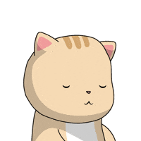
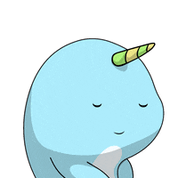


Thank you!

