Slide 1
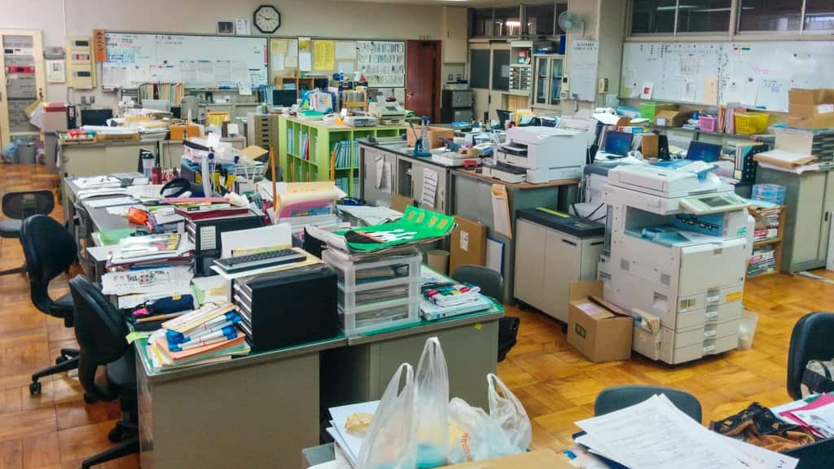
School Etiquette & Navigating the Staffroom

Slide 2

First Things First:
ESID

Slide 3
Navigating the Staffroom
Mornings
Morning Greeting, as soon as you enter the staffroom
Loud “Ohayo Gozaimasu”
No need to shout, just loud/confident
O-hai-yo Go-za-I-E-mas
Polite Form
Just Ohayo is informal and used more for friends than coworkers
Never use Ohayo with superiors
Important to arrive early, usually small 10 minute morning meetings
All in Japanese but just look like you’re paying attention, you can ask your JTE after it’s finished

Slide 4
Navigating the Staffroom
Evenings
When anyone leaves for the day
Small bow, and “Osaki ni Shitsureishimasu” to everyone you pass as you leave, not just one big greeting like the morning
O-sa-kay Knee She-tsu-rey-she-mas
They head nod in return and say “Ostukaresama desu” or “Ostukare”
O-tsu-ka-rey-sama des O-tsu-ka-rey
Saying it directly to your VP if he’s still in the room is polite too
Occasionally afterschool meetings
These are very ‘official’ meetings and you can’t leave during them, it’s seen as very rude
If you have somewhere to be after school ends and you know there is a meeting, try to leave before it starts

Slide 5
Navigating the Staffroom
Principal - Kouchyou-sensei
Vice Principal - Kyouutou-sensei
You can just use their titles since they’re so important, you can add their name before it if you remember
Will have your own desk
Make sure to always have your official stamp/seal (hanko) on you, it’s essentially your signature
Might have some leftovers from your predecessor
Typically given your own work PC, not great but good enough
Most schools won’t let you use their wifi, security measure
Used my phone for data hotspot if I needed to (good to have phone plan with lots of data)
Notes:
With no internet for the first few weeks I did easily use 20 GB of data in my home alone
If unable to ask BOE before leaving, try asking your predecessor if you’re allowed to have contact with them

Slide 6
Building Good Relationships
Be nice, polite, respectful
Keigo not necessary, polite form of Japanese necessary –masu, desu endings
Work hard, or at least look like you’re working hard
Can stay late past your ‘determined’ ending time, but don’t have to
You’re salary not hourly
Staying late, even just 10 minutes, is seen as you working hard and trying your best, building brownie points, and will be appreciated
I would stay late if I had more work to do and wanted to use the staff tools, like the printer or the pc
I’d also stay late depending on which bus I’d take, sometimes I’d be there 30 minutes past my leave time, but it was winter and the bus stop has no cover, so I just looked busy
You will not always have work to do, get used to looking busy

Slide 7
Making Friends
A lot of your coworkers will want to talk to you, but will be shy/nervous about it
Some of the older ones won’t be as shy because they simply don’t care anymore and are very out-going
Shyness is typically due to the fact they don’t speak a lot of English, so they worry about making mistakes and not being understood
It’s totally ok to use Google Translate, and the teachers will even use it back
Even the VP might use it if they need to ask you a question personally
Do attempt to speak Japanese as much as possible though, all attempts are seen as positive and you trying your best

Slide 8
Impolite Topics to Ask About
How old someone is
They all look younger than they really are
Relationship status
Typically, most men wear wedding rings, but most women don’t
It’s a jewelry policy for schools, they’re trying to be good examples for the kids
Even the kids won’t know the teacher’s relationship status
We waited until the end of the school year to announce that one teacher got engaged, just so the kids didn’t get distracted for finals

Slide 9
Omiyage
Souvenirs, most commonly in the form of food, doesn’t have to be anything big
When first arriving, it is polite to bring Omiyage from your home country
Most enjoyed are sour things or unique things
The “American version” is always appreciated too
You don’t have to worry about allergies, omiyage is always appreciated even if someone can’t eat it
It’s the thought that counts
When returning from trips, even to another prefecture, it’s polite to bring back Omiyage
Easy to buy at places like train stations, sweets shops,
road stations (michi no eki) kind of similar to Mavericks or Buccees

Slide 10
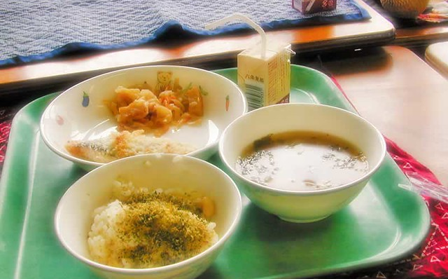
School Lunch
きゅうしょく / 給食 kyuushyoku
School lunch is provided, Very Healthy
Get the next month’s menu the previous month
NOT provided lunch during holidays, special event days, or school breaks
Bring your own lunch
Have to pay for school lunch, 300 yen a meal
Pay for lunch after the month is over
Receive receipt from school that you can pay at the コンビニ
Can opt out of the whole month or just a few days, just tell the office staff, they make you sign a paper
If your own lunch needs to be refrigerated or microwaved, can do that in the staff office room
Lunch staff usually pre-portion out lunch dishes during the last period before lunch, so you can just grab one set/tray at lunchtime

Slide 11
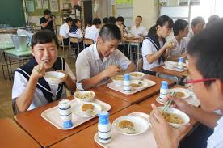
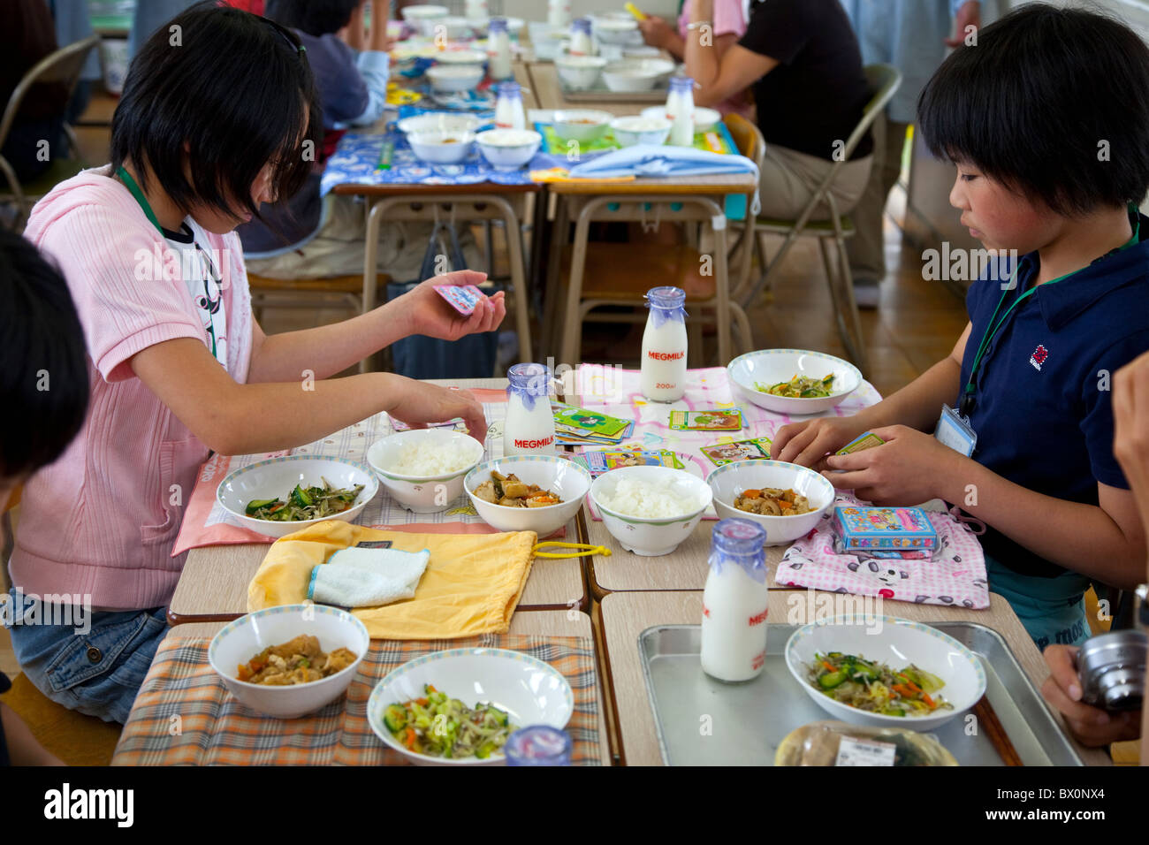
School Lunch
Kids eat fast so they can run and play
Serve themselves in their classrooms and clean up
Cafeterias aren’t typical
OK to join in eating with them if you want, just ask their homeroom teacher
Around 30 minutes for lunch, 10 minutes for clean up

Slide 12
What to Bring For Lunch

Slide 13
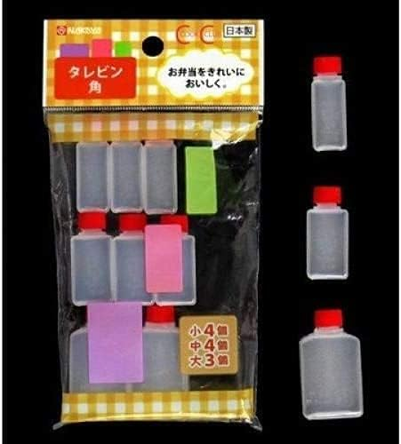
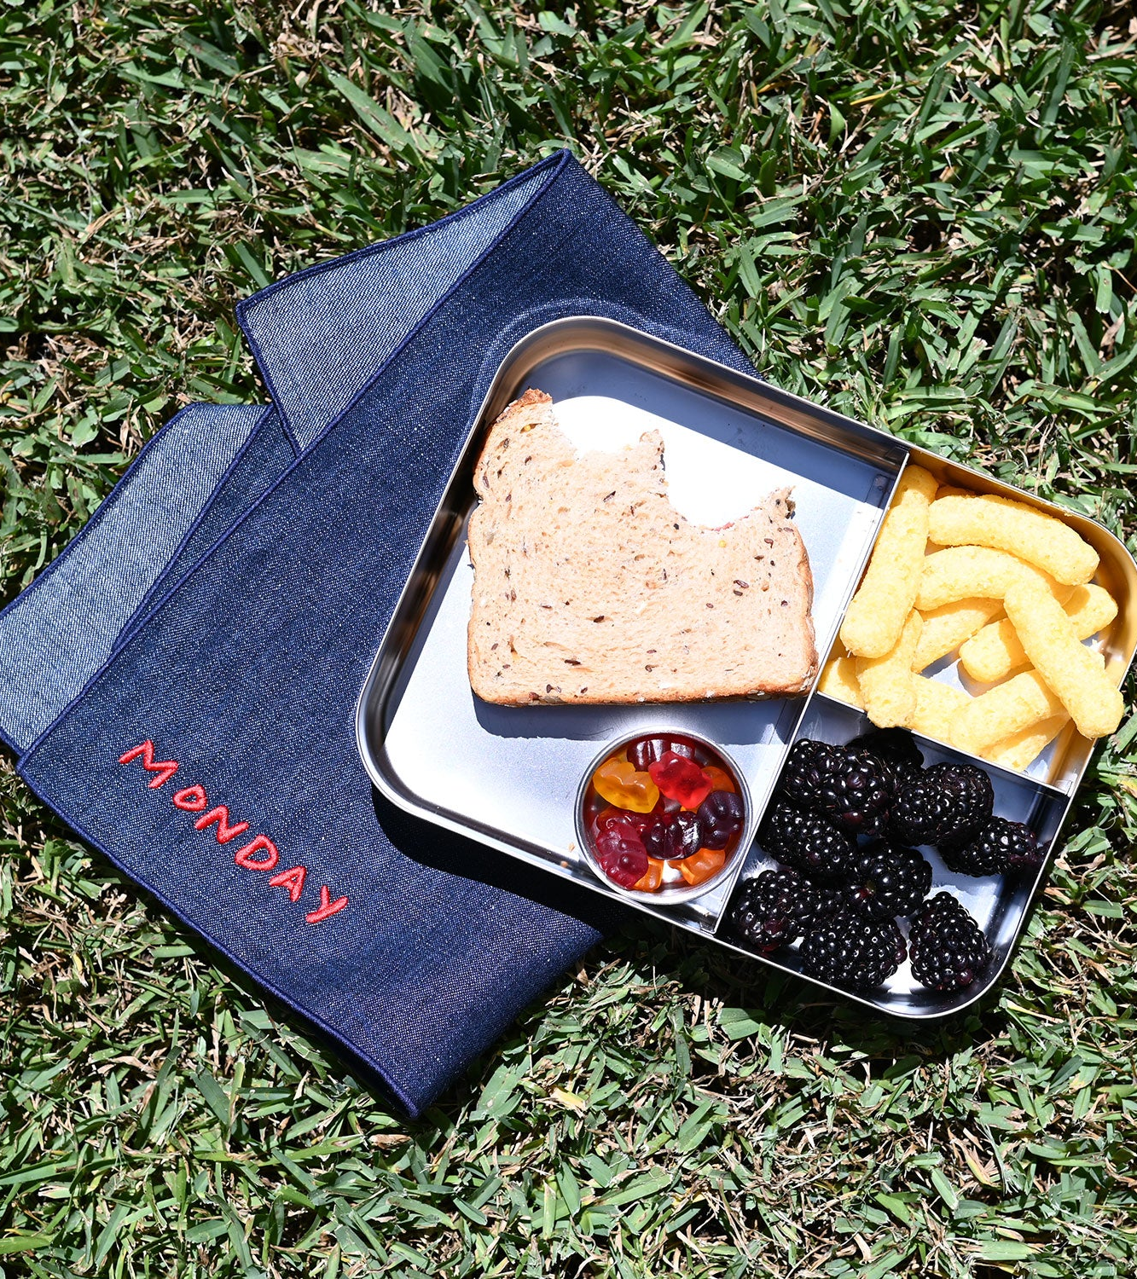
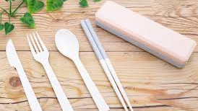
Chopsticks/Knife/Fork
Spoons for soup are usually provided, miso soup is a very common side dish
If you want seasonings, bring them
Disposable chopsticks a good idea, utensils aren’t always handed out
Fellow JET kept soy sauce in his desk
Big handkerchief looking thing to go under your bento box if you bring your own lunch (cleanliness reasons)
Actual handkerchief for when you wash your hands as paper towels are not a thing
Easy to get at Diaso or other hundred yen stores

Slide 14
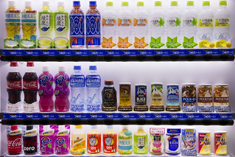
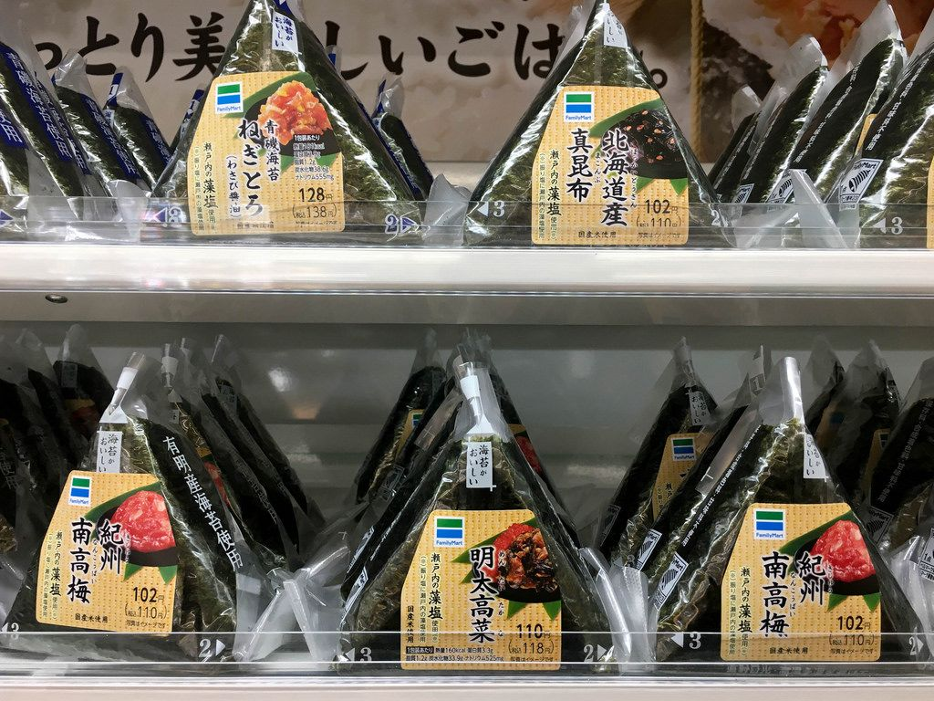
Snacks
Cannot bring snacks or drinks with you into the classroom, even during summer
Snacks and drinks are to be left in the staffroom/on your desk
Kids can’t have snacks at school or drinks besides water
Can bring whatever snacks/drinks you want, just make sure to be mindful of the people around you (not too noisy or smelly or messy)
Encouraged to bring healthy drinks, not energy drinks or soda, as you’re a role model for the children

Slide 15
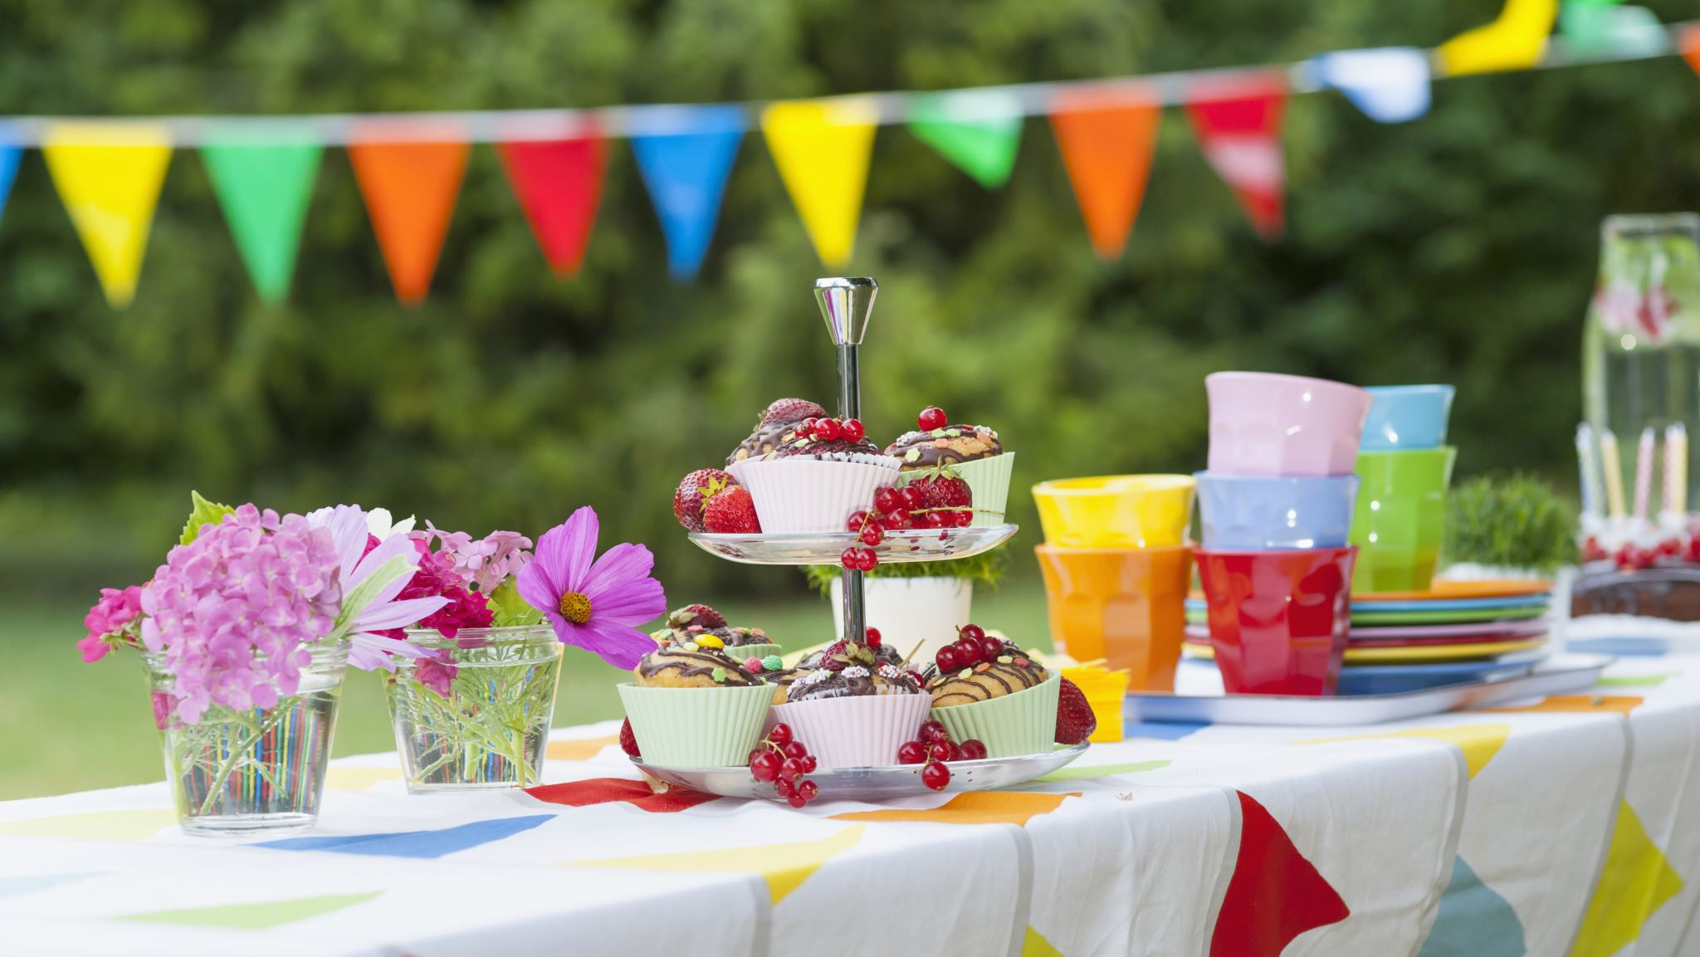
Nomikai

Slide 16
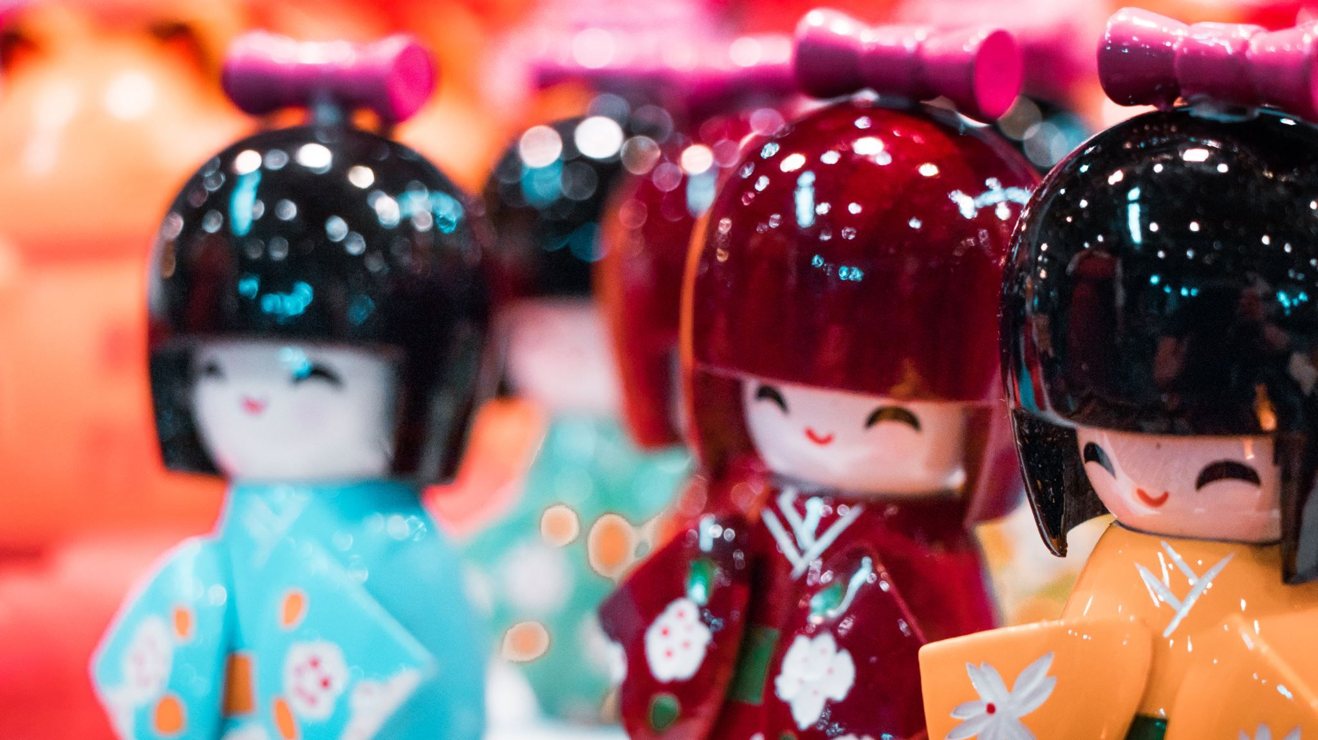
Nomikai
Drinking parties held 2x a year
December and April
Christmas/End of Year and End of School Year
Not required to go, but encouraged to go
Good socializing time
Cost around 6000Y, after party has subsequent cost, that is typically more drinking and karaoke
Usually held at a restaurant or hotel conference room

Slide 17
Drinking Culture
Not expected after work
Most teachers have their own families to return to
Most teachers work longer hours than we do
If they offer you’re more than welcome to accept

Slide 18
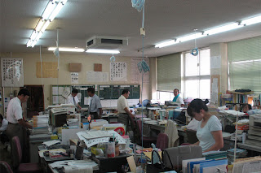

Slide 19
Questionsしつもん / 質問 shitsumonn
Helpful Youtube Channels
@LearnJapaneseChannel
@japanese_tanakasan
@Howzit_Japan
@Ninjapanese
@TOMOsensei
@Akane-JapaneseClass

