Slide 1


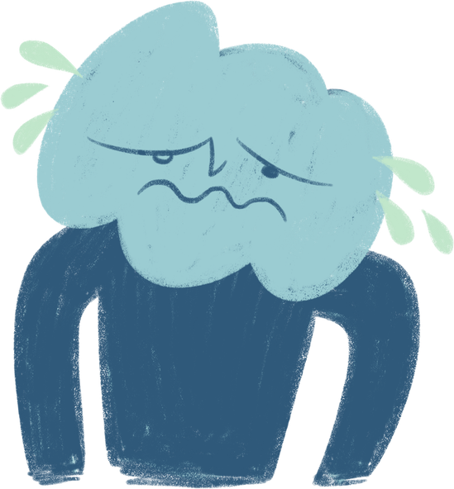

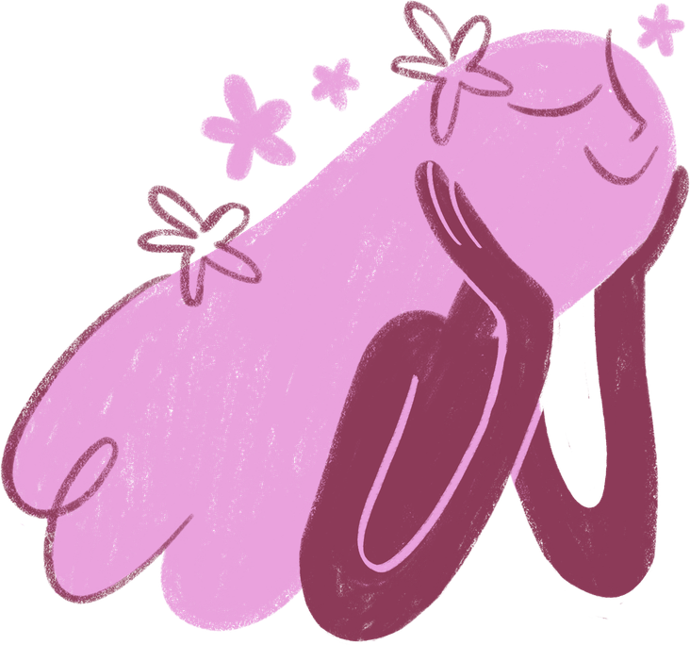
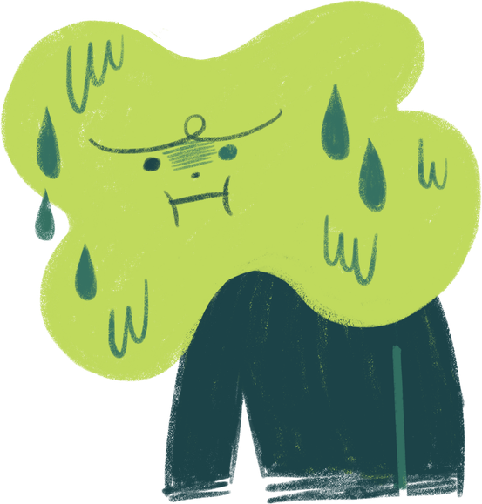
1
Mindset of a JET
with Catalina!
Portland JET Orientation 2026

Slide 2


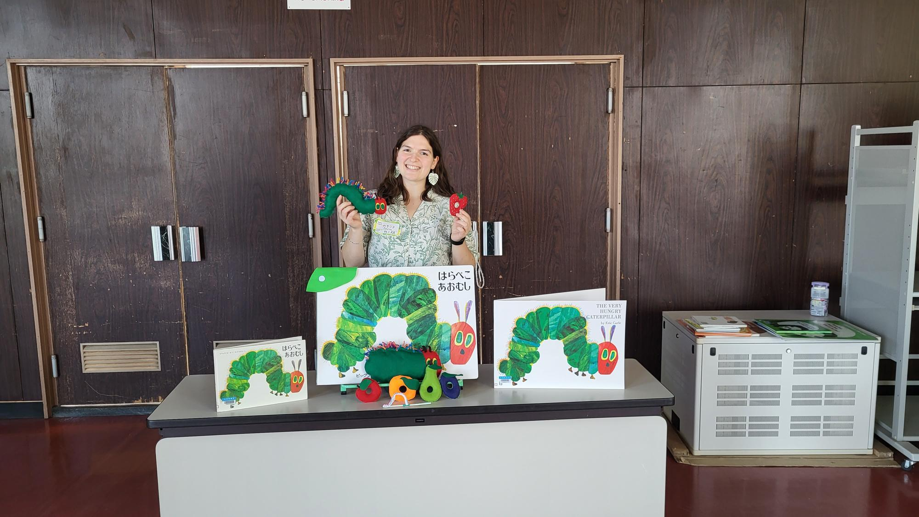
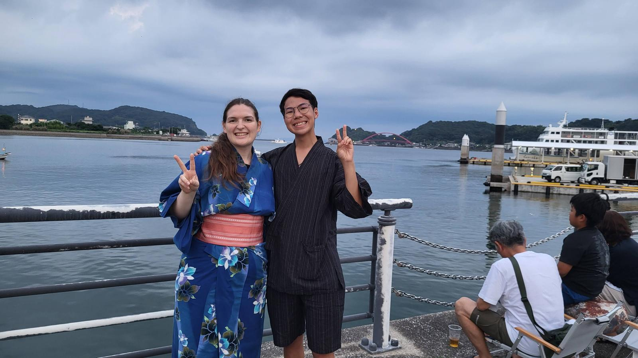
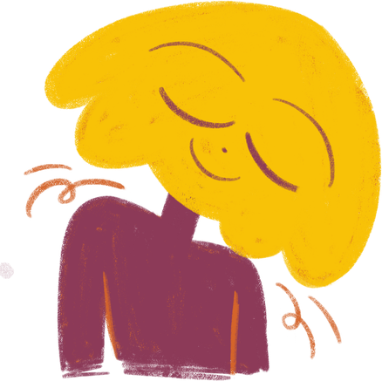

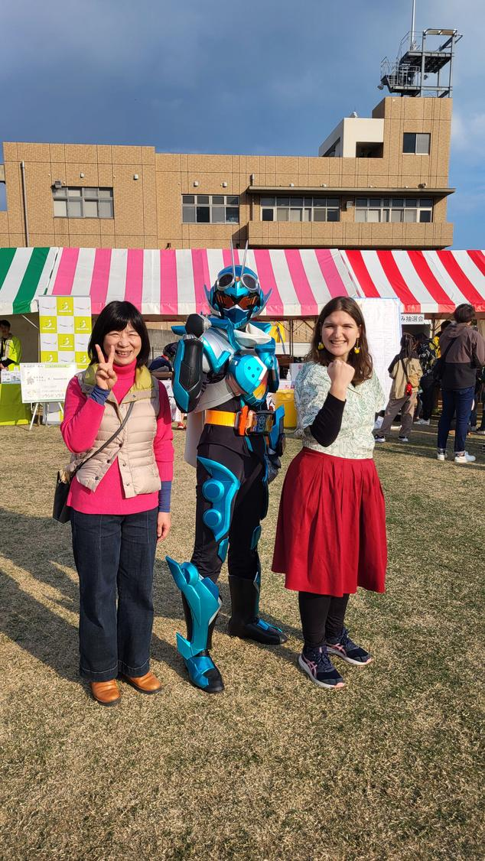
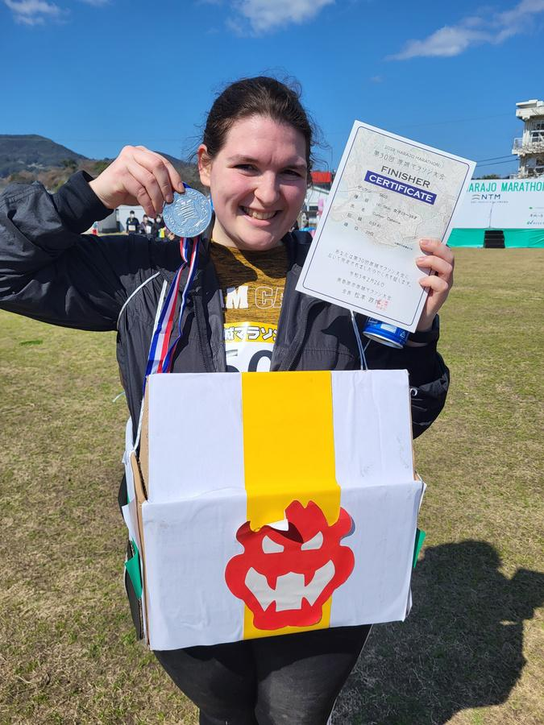
2
I’m Catalina!
  21-24 ALT in Minamishimabara in Nagasaki
  Drove all around Kyushu, visited Okinawa, Hokkaido and everything in between
  Played with the school Brass Band
  Volunteered at the local library
  learned JSL, ran a 5k twice, got dressed in yukata by obaachans, started a run club, went travelling solo so many times, found close friends, made cookies for my classes, hiked 10 mountains (and an active volcano), got covered in mud
  and almost NONE of this happened in the first 6 months

Slide 3
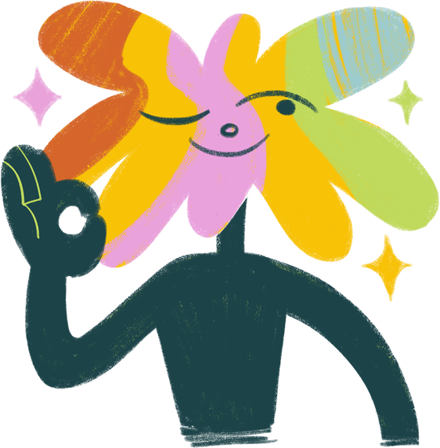
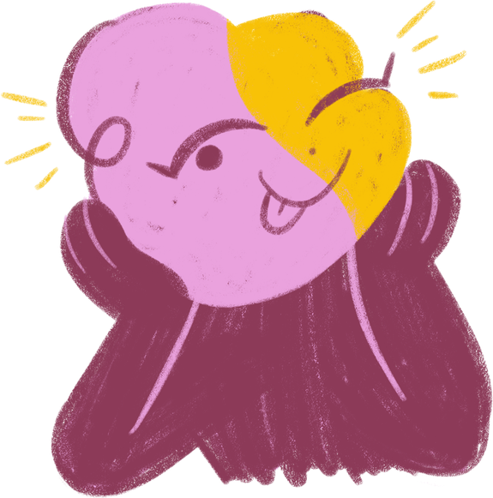

3
So you’re heading to Japan!

Slide 4
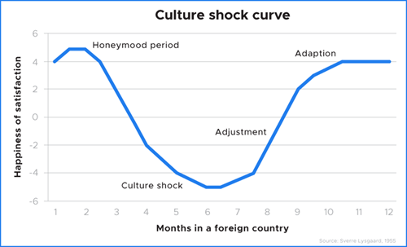

4
Culture Shock Roller Coaster
Feelings of
  Isolation as a foreigner
  Being put under a microscope in a small town
  Getting lost in a large city and not connecting
  Not fitting in with the other ALTs / feeling left out of already established friend groups
This is where your preparation means the most!

Slide 5


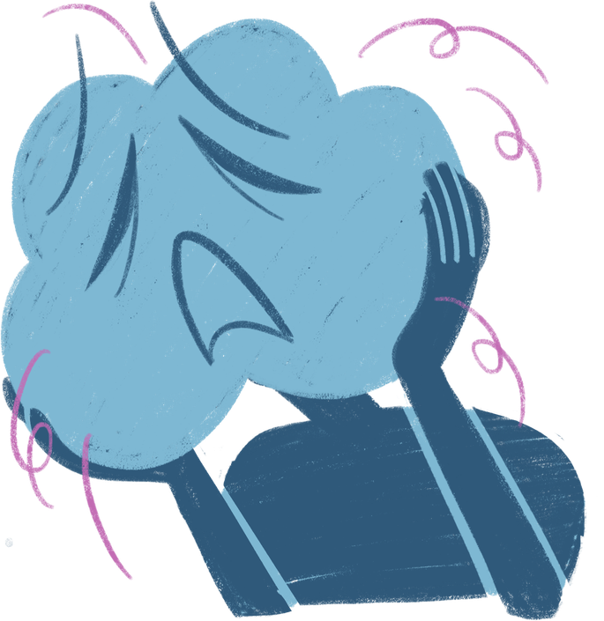
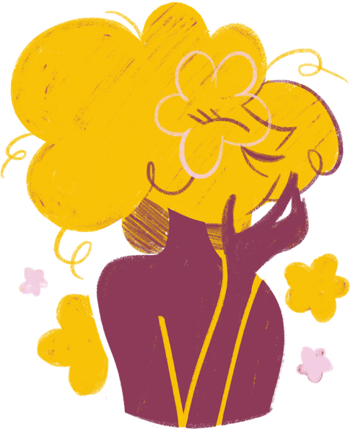
5
These feelings can be
Overwhelming
Anxious
Lonely
Frustrating
Angry
Cynicism, depression, isolation, malaise, surprise, small and unnoticed for a while

Slide 6


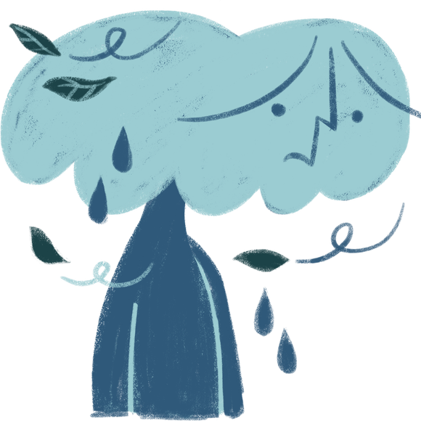


6
Sometimes it feels like things are going well... until they aren’t!
Small feelings will build up until they’re overwhelming.

Slide 7

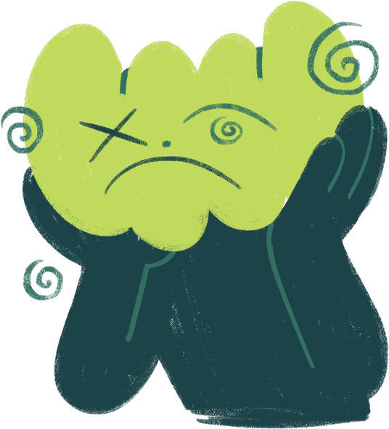
7
  Take a deep breath! Just because you make a mistake, the world will not end!!
    Lots of people are familiar with this role and will give you grace.
    If you say something wrong or make a mistake, acknowledge it and let it go! Don’t dwell on it.
  Journaling is a good way to just reflect on the day.
    This doesn’t have to be writing a diary entry!
    List good things that happened that day
    It can be reviewing pictures you took, balancing your bank card, or even just going through the day in your head.
  If something happened that you didn’t like or wanted to change with someone, SAY SOMETHING!! Take some time to yourself, but don’t let it fester!
  Overwhelming/Anxious → Practice Mindfulness
Sunny
Rainy

Slide 8


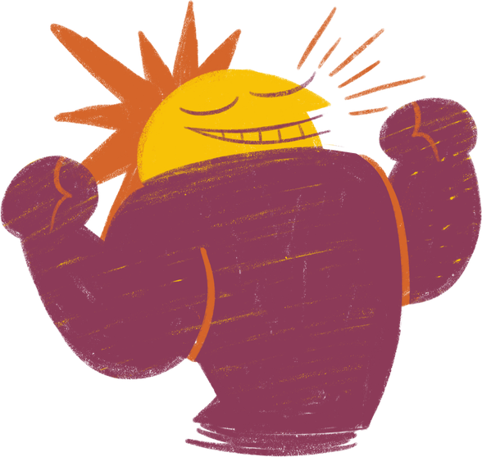

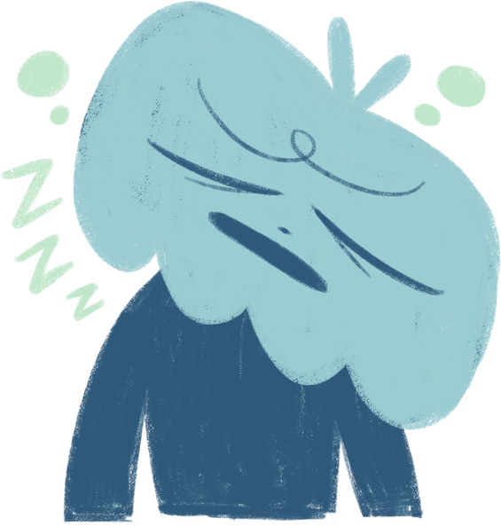
2. Loneliness → Foster Strong Connections at Home!
8
  Put time zones for family and friends into your Clock app on your phone so you know when to call!
  What is a good way to stay connected? (This will look different for different people in your life!!)
    Physical letters?
    Digital newsletters?
    Making YouTube videos
Face time
  Collect Addresses for Friends and Family- everyone loves to get a postcard!!
  Be Kind and Give Grace
    Friendships and relationships will look different across the ocean. Let people take time to respond and make an effort to respond, even if it’s late!

Slide 9
3. Frustrating/Angry → Focus on what you can do!
9
  Teachers suck → Focus on the students. What can you do in class?
  Students suck → Try to build relationships with the other teachers. Try Home Ec, join in for Sports Day
  School sucks → Focus on your community. There’s so much to do in your town!! Visit the library, volunteer at a local event. Sign up to learn something new! (Sign language, sports, ikebana, the possibilities are endless!)
  ALTs suck → build relationships with your community members. Start a conversation with your conbini employee. Go to a small store and ask a basic question.
  Your teachers may not be great, your students may not pay attention, the other ALTs have a boatload of drama, the school is so far from home.... and on and on
  There’s a lot of things that happen. It’s ok to be annoyed, frustrated or angry. But think about what that can do for you- nothing. You’re in a foreign country for a year. Let’s make the best of it.

Slide 10

10
  Write down tips or things to say. No one cares that your Japanese isn’t perfect. They care that you TRY.
    Talk about something that isn’t Japanese. People love to hear about new things
    Know the things that are popular for different people
      My middle school girls loved Kpop and my boys loved sports (Messi!)
      Lean on the FIFA World Cup, or whatever is in the news!
  Have something to fall back on
    this could be a game or something to break the ice
    don’t wait around for someone to suggest an answer to your problem
  If you mess something up, apologize once and MOVE ON.
Don’t Be Afraid to Fail.
You will fail. Period. It will happen!!
Don’t let it consume you!
No one wants you to feel helpless, they WANT to help.
Happy

Slide 11
  Know the things that keep you sane and bring them with you. You don’t have to touch them the first few months, but you’ll be glad to have them when December hits
    Have a friend pack a wrapped present
    Bring some treats that are packed away for a bad day
    Take time away from people if you need it
      You don’t have to say yes to everything- you will burn out!
  Keep mentally balanced - this could look like
    Keeping a journal
    going to therapy
    going on walks
    talking to family or friends
    getting outside when you REALLY don’t want to
  Culture shock isn't this huge wave that crashes over you, it’s the small things that build up over time.
    give yourself grace daily
  Just how culture shock doesn’t happen all at once, neither will building skills in grace and internal validation
11
Be kind to yourself.

Slide 12
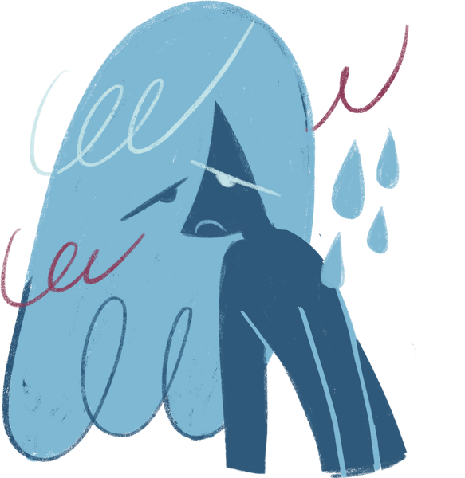
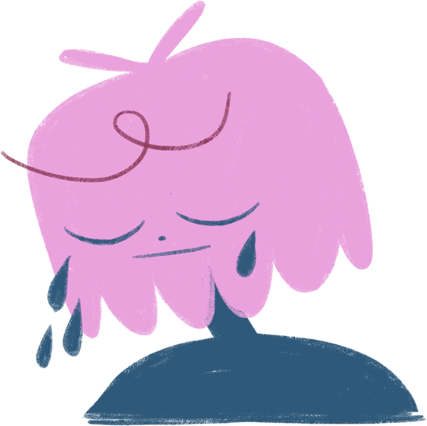
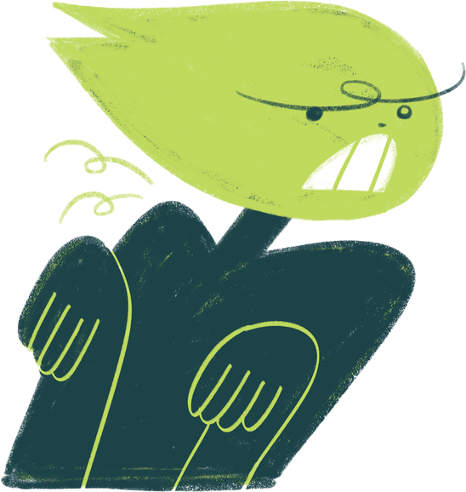

12
ABOVE ALL
  DRINK WATER
  GO TO SLEEP
  TAKE MANY SHOWERS (its so humid)
  TRY NEW THINGS
  YOU ARE NOT ALONE!

Slide 13

13
Thank you!

