Slide 1
Cultural Mindset:
Strategies for Thriving in Japan
Emily N. | June 24, 2026

Slide 2
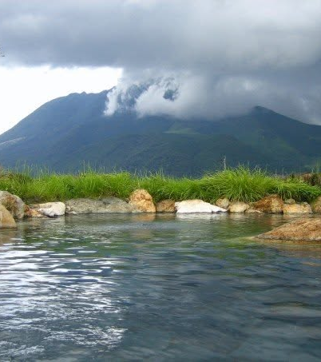
Purpose & Frameworks
Learn mental tools and strategies for navigating Japan (or any new environment)
Challenge by Choice / The Learning Zone Model
Culture Shock Curve

Slide 3
Jikoshoukai/About Me
Fukuoka (Kyushu) 2004-2007
Small rural city (pop 30,000)
My JET approach: A leap of faith—with support
Currently international program manager at a large university, involved in local JETAA chapter
Notes:
If it exists in the digital realm, like a google
doc or presentation, we ask that you
remove campaign branding at your
earliest convenience.
If it’s a new piece developed between
now and 7/1, we will not be placing campaign branding on it (except in the pilot program
I mentioned before).
If it’s a completed piece that’s out in the world, such as the ARP or a video, we will NOT be going back in and changing the branding–these pieces exist as artifacts of their time, and do not need to be updated.
If you have 500 printed copies of something with campaign branding, you can keep using them until 7/1.

Slide 4
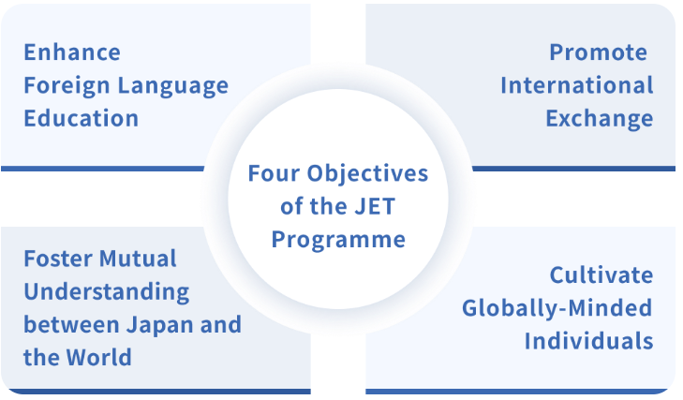
Four JET objectives
Translation: People-to-people diplomacy through English instruction in public schools. Change—by way of exchange.

Slide 5

Change can be rough

Slide 6
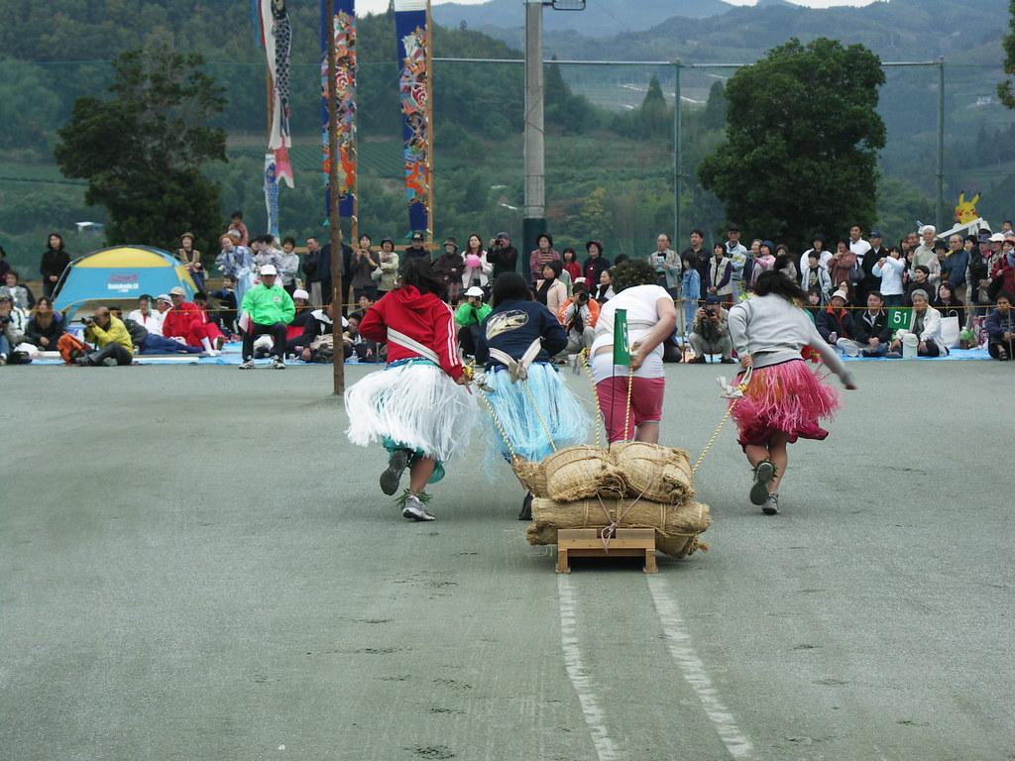
Challenge by Choice
You have agency in your experience!
Choose your level of involvement
Adjust your degree of difficulty
Measure growth against yourself, not others
You’ve chosen to challenge yourself by going on JET. Congratulations!

Slide 7
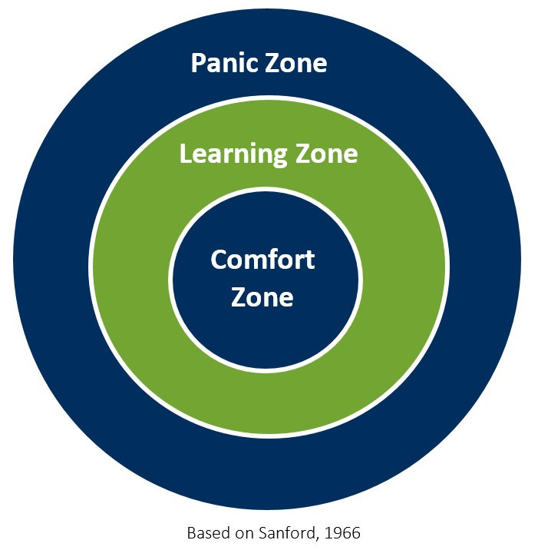
The Learning Zone Model
Who or what makes your Comfort Zone comfortable?

Slide 8
The Learning Zone Model
Who or what makes your Comfort Zone comfortable?
Familiar people and communities
Your home culture
Your physical home
Foods
Amenities and services
Language
Knowing what to expect and how things work

Slide 9
The Learning Zone Model
Think of a time when you went out of your Comfort Zone. What made it uncomfortable?

Slide 10
The Learning Zone Model
Think of a time when you went out of your Comfort Zone. What made it uncomfortable?
Uncertainty
A lot of new info to process
Stress
Heightened risk of failure

Slide 11
The Learning Zone Model
Comfort Zone: Routine, minimal challenge, high-functioning
Learning Zone: A place of calculated risk, skill development, confidence building, and productive friction
The Panic Zone: High stress, overwhelming unknowns, "why did I come here?"

Slide 12


Navigating the Zones
Starting Over: Expect to feel infantilized (e.g., language barriers, daily tasks)
Embrace the Journey: Recognize and celebrate growth (e.g., reading a sign, navigating a store)
Measuring Growth: The perspective gained when hosting visitors from home

Slide 13

Tools for Navigation (Part 1)
Curiosity: Staying open-minded
Humility: Accept being a beginner; rely on gestures and laughter
Humor: The ability to laugh at yourself, the situation
Wonder/Awe: Staying engaged with your surroundings

Slide 14
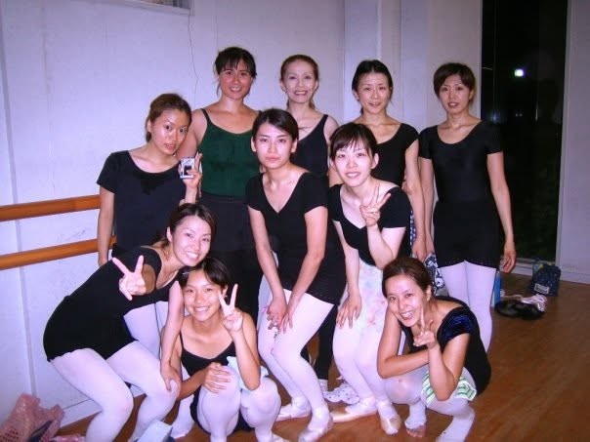
Tools for Navigation (Part 2)
Resolve: Getting things done despite being "bad" at them
Community: You are not alone; use AJET Peer Support, CLAIR, and your peers
Journaling: Use hand-written journals to process impressions
Self-Knowledge: Knowing what fills your cup

Slide 15
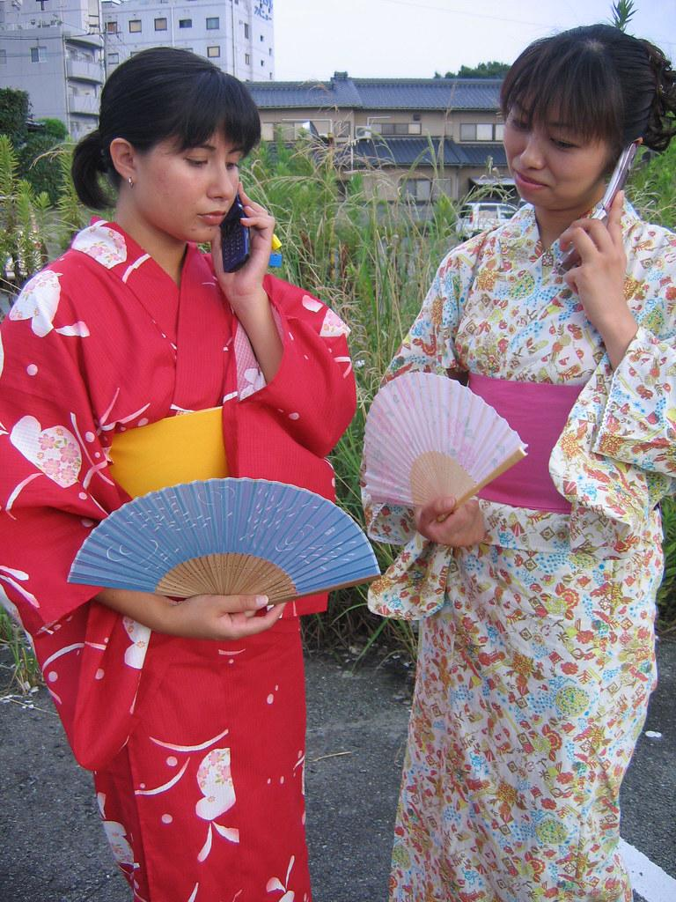
Tools for Navigation (Part 3)
Smartphones and Social Media: When does a tool become a crutch?

Slide 16
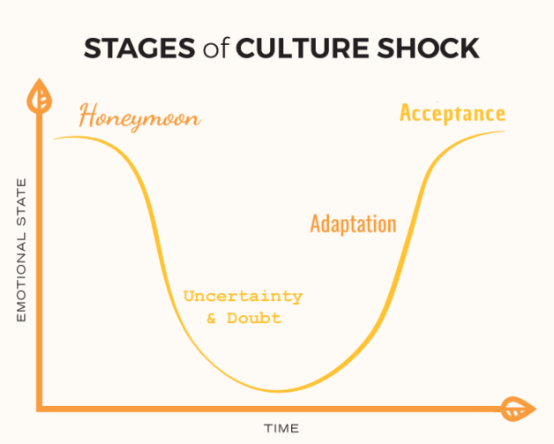
Culture Shock Curve

Slide 17
Culture Shock Stages
Honeymoon
Uncertainty & Doubt
Adaptation / Acceptance
Excitement, optimism, wonder
Anxiety or feelings or suprise
Disorientation or confusion
Moral and aesthetic disgust
Increased self-confidence, motivation, cultural sensitivity
Start expanding social networks and exploring new ideas
Increasingly flexible and objective
Practice parts of the new culture while also holding on to own cultural traditions
Changes in eating and sleeping
Homesickness, contacting home more often
Hostility and complaining
Instability, sadness, depression
Frustration, anger
Self doubt, sense of failure
Recurrent illness
Withdrawing from friends and family
- May be sudden or gradual.
- Length may vary depending on level
of self-awareness & length of stay

Slide 18
Navigating Culture Shock
Curiosity: Staying open-minded
Humility: Accept being a beginner; rely on gestures and laughter
Humor: The ability to laugh at yourself, the situation
Wonder/Awe: Staying engaged with your surroundings
Resolve: Getting things done despite being "bad" at them
Community: You are not alone; use AJET Peer Support, CLAIR, and your peers
Journaling: Use hand-written journals to process impressions
Self-Knowledge: Knowing what fills your cup
Smartphones & Social Media: ??

Slide 19
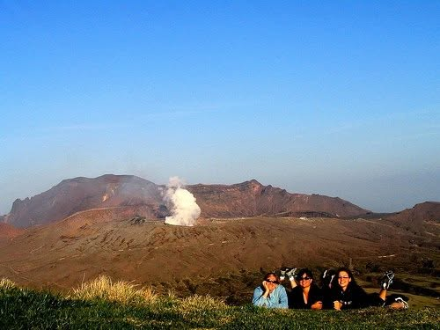
Final Takeaways
You’ve signed up for a “Challenge by Choice.” It will be challenging! And rewarding.
The travel stories we share most usually are not when everything went smoothly.
Surrender to the process, ask for help, and identify what grounds you.
Curiosity and humility will take you far.
Teaching English is the organizing principle. The real purpose and power of JET is people-to-people diplomacy.

Slide 20
Further Resources
The Learning Zone
The Learning Zone (YouTube)
Why Do We Feel Awe? by Dacher Keltner
Conversational Ballgames (PDF) by Nancy Masterson Sakamoto
Dimensions of Culture by Geert Hofstede
Hofstede Model: Comparative Analysis (Japan and the U.S.)

